Slide 1
External Access Services (EAS) – OAK 2.0 Requirements

Slide 2
Scope Executive Summary – EAS: Virtual Apps & Desktops
Support | Dev | Hybrid
Solution Description
 | Design | Build | Test/ QA | Op Support | Ongoing Development | Change Management | Decommissioning
VA&D | Y | Y | Y | Y | Y | Y | Y
Virtual Apps & Desktops (VA&D)
An enterprise VDI solution (cloud / Edge/ hybrid) for employee and partner access. Support both vendor- & customer-assembled models. Current solution is a predominately Azure-hosted, fully Citrix-based estate with ~22K users. Supplier to modernize during 2026, migrating all users to modern, secure, & scalable platform such as Windows365, native AVD+Nerdio.
Identified as a Digital Crown Jewel at GSK
Dependency/linkage/synergy with any other Workpackages:
Cloud and LAN/WAN Network Infrastructure
Identity and Access Management
CSO, Global Risk and Compliance
Task Details & Expected Outcomes
Fully responsible for current solution and all activities to modernize VDI solution(s) at GSK, with subsequent ongoing responsibility as scoped. Supplier shall assess current estate, define target architecture, map users & workloads to new product set, engage with tech providers, develop & execute a migration plan, project management & governance, user comms & change management, running POC & early adopter activities, user acceptance testing, decommissioning the old Citrix-estate by end 2026.
The Supplier will have full end-to-end responsibility for the service, covering design, build, operations, and continuous improvement. The service must be scalable, cost-optimised, fit for purpose, and fully aligned with GSK standards, policies, and ITIL practices. GSK will provide Engineering and Product Ownership only; all other aspects are owned and delivered by the Supplier. The Supplier is expected to leverage AI and automation to reduce incidents, improve customer experience, and drive ongoing service optimisation..
.
Dev Scope
 | Incidents | Problems | Changes | Requests
VA&D | 20000 | 3 | 650 | 9500
Ticket Summary
(Annualised)
AI First Strategy
Product Strategy/2026 Major Milestones
Focus on improved monitoring and observability to support AI Ops.​
Expertise in the platforms and investment in tooling to support GP&T AI Ops goals.​
Use AI and automation to improve service reliability, speed repairs and improve CX.
Migration of users from current Citrix estate to secure, modern, scalable VDI solution offering performance, scaling and cost advantages
2
CONFIDENTIAL

Slide 3
Scope Executive Summary – EAS: VDI Gateway Services
Support | Dev | Hybrid
Solution Description
VDI Gateway Services
VDI access gateway solution (cloud / Edge / hybrid) for employee and partner access. Current solution is a combination of Citrix NetScalers and Citrix cloud-based gateways with plans to migrate to a modern, secure, & scalable platform.
Dependency/linkage/synergy with any other Workpackages:
Cloud and LAN/WAN Network Infrastructure
Identity and Access Management
CSO, Global Risk and Compliance
Virtual Apps and Desktops
Current contract with Citrix expires in 2027.
Expertise with design, build, ops support, ongoing development, improving user experience, change management, service reporting and communications, and decommissioning. Must use AI to deliver tangible improvements.
Task Details & Expected Outcomes
The Supplier will have full end-to-end responsibility for the service, covering design, build, operations, and continuous improvement. The service must be scalable, cost-optimised, fit for purpose, and fully aligned with GSK standards, policies, and ITIL practices. GSK will provide Engineering and Product Ownership only; all other aspects are owned and delivered by the Supplier. The Supplier is expected to leverage AI and automation to reduce incidents, improve customer experience, and drive ongoing service optimisation.Responsible for current product set, activities to modernise solution(s) then ongoing responsibility as scoped.
Responsible for assessing the current estate, defining and building a target architecture, mapping users & workloads, engaging with tech providers, developing & executing a migration plan, project management & governance, user comms & change management, running POC & early adopter activities, user acceptance testing, decommissioning the old Citrix gateways
Staff should be properly trained in VDI access gateway solutions including Citrix, W365, AVD+Nerdio
 | Design | Build | Test/ QA | Op Support | Ongoing Development | Change Management | Decommissioning
NetScaler (Citrix gateway) | Y | Y | Y | Y | Y | Y | Y
Dev Scope
 | Incidents | Problems | Changes | Requests
NetScaler (Citrix gateway) | 20 | 0 | 106 | 0
Ticket Summary
(Annualised)
AI First Strategy
Product Strategy/2026 Major Milestones
Focus on improved monitoring and observability to support AI Ops.​
Expertise in the platforms and investment in tooling to support GP&T AI Ops goals.​
Use AI and automation to improve service reliability, speed repairs and improve CX.
Migration from current Citrix gateway solutions to a secure, modern, scalable gateway solution that integrates with the strategic VDI solution
3
GSK Confidential – Not for External Distribution
CONFIDENTIAL

Slide 4
Scope Executive Summary – EAS: Managed File Transfer
Support | Dev | Hybrid
Solution Description
 | Design | Build | Test/ QA | Op Support | Ongoing Development | Change Management | Decommissioning
MFT | Y | Y | Y | Y | Y | Y | Y
Managed File Transfer (MFT)
Enables data sharing through a secure and reliable delivery method based on GoAnyWhere MFT, ensuring the protection of proprietary and personal data both in transit and at rest. Uses standard protocols (SFTP(SSH), Https, AS2). Service is hosted in Azure. Uses secure dropboxes as well as automated transfers, integrated in numerous critical applications. Ensures secure, policy-driven file exchange with encryption, automation, and monitoring. Files are moved between the IT and OT networks as well as exchanges between GSK and external partners. Essential for numerous business critical applications and services.
Dependency/linkage/synergy with any other Workpackages:
Cloud and LAN/WAN Network Infrastructure
Identity and Access Management
CSO, Global Risk and Compliance
Business application integration
Current solution is cloud-hosted GoAnyWhere MFT, contract expires 2027.
Expertise with product specific design, build, Ops support, ongoing development, improving user experience, change management, service reporting and communications, and decommissioning
Task Details & Expected Outcomes
The Supplier will have full end-to-end responsibility for the service, covering design, build, operations, and continuous improvement. The service must be scalable, cost-optimised, fit for purpose, and fully aligned with GSK standards, policies, and ITIL practices. GSK will provide Engineering and Product Ownership only; all other aspects are owned and delivered by the Supplier. The Supplier is expected to leverage AI and automation to reduce incidents, improve customer experience, and drive ongoing service optimisation.
Dev Scope
 | Incidents | Problems | Changes | Requests
MFT | 850 | 0 | 35 | 1150
Ticket Summary
(Annualised)
AI First Strategy
Product Strategy/2026 Major Milestones
Focus on improved monitoring and observability to support AI Ops.​
Expertise in the platforms and investment in tooling to support GP&T AI Ops goals.​
Use AI and automation to improve service reliability, speed repairs and improve CX.
Increase scope/volumes to incorporate further secure exchange between IT and OT networks.
4
GSK Confidential – Not for External Distribution
CONFIDENTIAL

Slide 5
Scope Executive Summary – EAS: Web Services Security Gateway (WSSG)
Support | Dev | Hybrid
Solution Description
 | Design | Build | Test/ QA | Op Support | Ongoing Development | Change Management | Decommissioning
WSSG | Y | Y | Y | Y | Y | Y | Y
Web Services Security Gateway (WSSG)
Web Services Security Gateway based on IBM DataPower, facilitates gateway services for inbound and outbound HTTPS calls. It ensures SSL authentication along with message-level authentication and authorization for every transaction. Cloud-hosted gateways for secure structured data exchange over internet protocols..
Identified as a Digital Crown Jewel at GSK
Dependency/linkage/synergy with any other Workpackages:
Cloud and Network Infrastructure
Identity and Access Management
CSO, Global Risk and Compliance
Business application integration
Middleware (B2B)
Current IBM contract expires 2029.
Expertise with design, build, Ops support, ongoing development, improving user experience, change management, service reporting and communications, and decommissioning
Task Details & Expected Outcomes
The Supplier will have full end-to-end responsibility for the service, covering design, build, operations, and continuous improvement. The service must be scalable, cost-optimised, fit for purpose, and fully aligned with GSK standards, policies, and ITIL practices. GSK will provide Engineering and Product Ownership only; all other aspects are owned and delivered by the Supplier. The Supplier is expected to leverage AI and automation to reduce incidents, improve customer experience, and drive ongoing service optimisation.
Dev Scope
 | Incidents | Problems | Changes | Requests
WSSG | 50 | 0 | 15 | 15
Ticket Summary
(Annualised)
AI First Strategy
Product Strategy/2026 Major Milestones
Focus on improved monitoring and observability to support AI Ops.​
Expertise in the platforms and investment in tooling to support GP&T AI Ops goals.​
Use AI and automation to improve service reliability, speed repairs and improve CX.
No major strategy changes expected.
5
GSK Confidential – Not for External Distribution
CONFIDENTIAL

Slide 6
Scope Detail – EAS: Virtual Apps & Desktops
App/ Service Name | Description of App/ Service | 2025 Service Volumes (Current average number of Sprints/ Story Points/ Tickets per month) | Expected Year 1 Service volumes (Future number of Sprints/ Story Points/ Tickets per month) | Expected Year 2 Service volumes (Future number of Sprints/ Story Points/ Tickets per month) | Expected Year 3 Service volumes (Future number of Sprints/ Story Points/ Tickets per month) | Other variables (e.g., Number of Users, Number of instances) | Language + Location Requirements (leave blank if not applicable) | Availability (e.g., 24 x 7)
VA&D | Virtual Apps and Desktop services as a whole | 20,500 incidents 1000 requests 635 changes | [Year of transformation] | Materially lower than 2025 | Lower than Year 2 | See below |  | 24x7x365
Persistent VDIs | Single-session Windows 11 VDI |  |  |  |  | 6500 VDIs 3 desktop images |  | 24x7x365
Multi-session VDIs | Multi-session Windows 11 VDI |  |  |  |  | 13500 VDIs Up to 20 desktop images |  | 24x7x365
Server-hosted desktop servers | Hosting virtualised apps and desktops not compatible with a desktop OS |  |  |  |  | 100 |  | 24x7x365
Citrix Cloud Controllers | Manage and broker user access |  |  |  |  | 15 |  | 24x7x365
RDSCal servers | Authorise and manage licensed desktop users |  |  |  |  | 5 |  | 24x7x365
Storefront Servers | Authenticate users and provides the personalised interface to the apps/desktops |  |  |  |  | 7 |  | 24x7x365
Ivanti servers | Desktop personalisation, profile and endpoint maanagement |  |  |  |  | 9 |  | 24x7x365
SQL servers | Database servers required by Ivanti |  |  |  |  | 2 |  | 24x7x365
6
CONFIDENTIAL

Slide 7
Scope Detail – EAS: Virtual Apps & Desktops
Scope Description
Application Dev/ Support Service Detail
The Supplier shall assume full and comprehensive responsibility for the service, including its design, build, implementation, and ongoing operational support. This responsibility spans all levels of the ITIL framework and includes proactive identification and delivery of service improvements throughout the lifecycle. As GSK’s internal roles are limited to Engineering and Product Ownership, the Supplier is expected to manage and operate the service in its entirety.
The service must be scalable, fit for purpose, and continuously optimised for performance, resilience, and cost-effectiveness. Supplier must ensure all solutions comply with GSK’s security policies, data protection standards, and relevant regulatory requirements (e.g., GDPR, GXP, SOX, HIPAA as applicable).
The Supplier is expected to leverage AI and automation to proactively reduce incidents, improve customer experience, and drive continuous service optimisation. Supplier shall implement AI Ops capabilities including but not limited to automated provisioning workflows, intelligent chatbot integrations for Tier 1 support, predictive analytics for performance degradation, and self-healing mechanisms. Consequently, Supplier shall commit to material reductions in incident volumes, with commercially backed KPIs
The Supplier shall ensure the service remains aligned with evolving business needs and technological advancements. This includes maintaining appropriate documentation, managing technical debt, and ensuring the service is secure, supportable, and maintainable. Clear governance structures, reporting mechanisms, and escalation paths must be in place to ensure transparency and accountability in service delivery.
GSK has a cloud-hosted VDI estate based on Citrix, serving approx. 22,000 users. Supplier will be responsible for end-to-end modernisation, establishing the new platforms and migrating users. GSK is anticipating this will be Windows365 and Azure Virtual Desktop with Nerdio. Supplier must execute the transition and eliminate Citrix (unless business requires exception, approved by GSK) by end 2026. Migrations shall be persona- and requirement-based, with solutions optimised for cost and performance. Supplier shall determine target architecture and migration plan, to be approved by GSK. Supplier shall:
Conduct discovery and assessment of the current Citrix environment.
Define and propose a target architecture.
Develop and execute a migration plan, subject to GSK approval
Engage with technology providers including Microsoft and Nerdio.
Run PoCs, early adopter pilots, and user acceptance testing to successful adoption
Supplier will have end-to-end responsibility for the new VDI platform(s) and any remaining Citrix implementation.
7
CONFIDENTIAL

Slide 8
Scope Detail – EAS: Virtual Apps & Desktops
Scope Description
Supplier shall:
Provide all necessary support and request management for any existing and additional environment requirements
Provide all necessary support relating to Cloud VDI API integration with third party technologies (SNOW or any monitoring tool)
Provision and manage GSK’s MCS or equivalent technology environment, both on-prem and cloud estate.
Provision, manage and automate provisioning including control, configuration and management of GSK VA&D environment
Understand user requirements, document and deploy the best suited solution to meet business needs in line with the VA&D Strategy
Advise, document, plan, deploy and maintain existing software / hardware (as per baseline) concurrency for GSK VA&D environment
Monitor, manage, recommend and maintain performance to ensure optimum user experience without impact and VDI performance.
Maintain, record, update and report on Demand and Capacity to ensure License and capacity compliance for the VA&D estate.
Propose, plan and implement measurable cost associated value adds for the GSK VA&D environment
Ensure vulnerabilities are assessed, actioned and reported upon for the VA&D environment for existing tools as per baseline
8
CONFIDENTIAL

Slide 9
Scope Detail – EAS: Virtual Apps & Desktops
Scope Description
Application Dev/ Support Service Detail (cont)
Current Citrix service description detail:
~21000 users, comprising 17000 external partners and 4000 internal (GSK)
16500 concurrent users (peak)
200+ external partners utilizing the service
Approx 65% multi-session VDIs, 35% single-session persistent VDIs
Approx 20 desktop images, (Click to Deploy)
Hosted in Azure IE1 and US6
Storage utilizes CVO, planned migration to ANF
~100 server-hosted desktop servers
8500 VDAs
200 apps in multi-session VDI, 600+ apps in persistent VDI (SCCM & InTune based)
Citrix Workspace Application version 2503 (CR)
VDA version 2402 CU1
10 siloed application servers, 13 siloed applications
Small on-prem instances in Wavre, Rosia, Rixensart, Sienna, APAC
Software and versions:
Personalisation and End Point Management : Ivanti AppSense Env Manager version 2025.2
FSLogix for profile management/personalisation/management
Windows Server OS 2k16 & 2k19
Client : CWA v 2503
DEX: NexThink – 23.X
Windows 11 desktop OS
Application Roadmap
The Supplier will lead the transformation of GSK’s Virtual Desktop Infrastructure (VDI), transitioning from the current Citrix-based estate by end 2026, as outlined above.
9
CONFIDENTIAL

Slide 10
Scope Detail – EAS: Virtual Apps & Desktops (cont.)
Scope Description
Application Dev/ Support Service Detail (cont.)
The Supplier must ensure that all personnel delivering services are appropriately trained, certified, and competent to perform their roles effectively. Services must be delivered in a secure, scalable, and cost-optimised manner, in full compliance with GSK’s policies, procedures, standards, and applicable data privacy and information security requirements. The Supplier is expected to proactively leverage AI, automation, and analytics to reduce incidents, improve customer experience, and drive continuous service optimisation. This includes identifying opportunities for innovation and value realisation throughout the service lifecycle. The following outlines key service areas and expectations, which are intended to be illustrative but not exhaustive.
Continuous Improvement
The Supplier shall implement a structured continuous improvement framework throughout the SOW term. This includes the use of AI and automation to reduce incident volumes, improve service quality, and enhance user satisfaction. Monthly reports must be provided to GSK detailing identified opportunities, actions taken, and progress against prior periods.
Audit, Compliance & Security
The Supplier is responsible for ensuring full compliance with all applicable GSK policies, procedures, and regulatory requirements. This includes supporting internal and external audits, remediating findings, and responding to penetration testing and vulnerability scans. The Supplier must maintain accurate compliance documentation, manage license usage, and ensure infrastructure qualification is documented and up to date. All services must be delivered in accordance with GSK’s data privacy and information security standards, including secure access controls, event logging, and breach response protocols.
Service Request Management
The Supplier shall manage and fulfil service requests via GSK’s Service Catalog and provisioning tools. This includes validating, categorising, and escalating requests as needed, maintaining accurate records in GSK’s ITSM systems, and ensuring all user-facing documentation and help content is current and accessible.
Incident Management
The Supplier shall monitor, manage, and resolve all incidents related to in-scope services in accordance with SLAs and SOPs. This includes conducting root cause analysis for major incidents, leading SWAT calls, and providing timely updates to stakeholders. All incident data must be accurately maintained in GSK’s ITSM tools, with regular reporting on trends and resolution performance.
10
CONFIDENTIAL

Slide 11
Scope Detail – EAS: Virtual Apps & Desktops (cont.)
Scope Description
Application Dev/ Support Service Detail (cont.)
Problem Management
The Supplier shall identify and resolve underlying problems through proactive trend analysis and root cause investigation. Preventative measures must be proposed and implemented to reduce recurrence, and all problem records must be maintained in accordance with GSK standards.
Change Management
The Supplier is responsible for planning, executing, and documenting all technical changes. This includes risk assessments, backout plans, stakeholder communications, and participation in Change Advisory Board (CAB) meetings. All changes must follow GSK’s change control processes and be fully documented in the ITSM system.
Escalation Management
The Supplier shall follow GSK’s defined escalation procedures for incidents, problems, and changes. All escalations must be logged, communicated, and resolved in line with agreed timelines. Root cause analysis and mitigation plans must be provided for major or recurring issues.
Asset & Configuration Management
The Supplier shall maintain accurate and complete asset and configuration data in GSK’s CMDB. This includes hardware, software, and system configurations, with quarterly verification of configuration items. Documentation must be aligned with OEM guidance, industry best practices, and GSK standards.
Knowledge Management
The Supplier shall be responsible for creating, maintaining, and continuously improving all knowledge assets related to the in-scope services. This includes service desk scripts, knowledge base (KB) articles, user guides, FAQs, and operational runbooks. All content must be accurate, up to date, and stored in GSK’s designated knowledge management systems. The Supplier must ensure that knowledge is accessible, searchable, and aligned with incident, problem, and request management processes to support first-time resolution and reduce repeat issues.
Governance & Reporting
The Supplier shall participate in regular governance forums and service reviews with GSK. This includes providing transparent reporting on performance, SLAs, risks, and improvement initiatives. Clear escalation paths and stakeholder engagement protocols must be maintained.
Innovation & Cost Optimisation
The Supplier is expected to continuously identify opportunities to optimise cost, improve efficiency, and introduce innovation. This includes the use of AI, automation, and emerging technologies to deliver measurable business value and align with GSK’s strategic objectives.
11
CONFIDENTIAL

Slide 12
Scope Detail – EAS: VDI Gateway Services
App/ Service Name | Description of App/ Service | 2025 Service Volumes (Current average number of Sprints/ Story Points/ Tickets per month) | Expected Year 1 Service volumes (Future number of Sprints/ Story Points/ Tickets per month) | Expected Year 2 Service volumes (Future number of Sprints/ Story Points/ Tickets per month) | Expected Year 3 Service volumes (Future number of Sprints/ Story Points/ Tickets per month) | Other variables (e.g., Number of Users, Number of instances) | Language + Location Requirements (leave blank if not applicable) | Availability (e.g., 24 x 7)
Netscaler | VDI gateway service | 16 PIs, 20 incidents annually | 16 PIs, 20 incidents annually | 16 PIs, 20 incidents annually | 16 PIs, 20 incidents annually | Prod/Test Gateways: 4 UK/US MPX 15000 1 US VPX 1000 3 UK VPX 10 3 Virtual NMAS/ADM servers | HA Pair within country; Geographic region failover | 24/7/365
Scope Description
Application Roadmap
Migration from current Citrix gateway solutions to a secure, modern, scalable gateway solution that integrates with the strategic VDI solution
Application Dev/ Support Service Detail
The Supplier shall assume full and comprehensive responsibility for the service, including its design, build, implementation, and ongoing operational support. This responsibility spans all levels of the ITIL framework and includes proactive identification and delivery of service improvements throughout the lifecycle. As GSK’s internal roles are limited to Engineering and Product Ownership, the Supplier is expected to manage and operate the service in its entirety.
The service must be scalable, fit for purpose, and continuously optimised for performance, resilience, and cost-effectiveness. Supplier must ensure all solutions comply with GSK’s security policies, data protection standards, and relevant regulatory requirements (e.g., GDPR, GXP, SOX, HIPAA as applicable).
The Supplier is expected to leverage AI and automation to proactively reduce incidents, improve customer experience, and drive continuous service optimisation. Supplier shall implement AI Ops capabilities including but not limited to automated provisioning workflows, intelligent chatbot integrations for Tier 1 support, predictive analytics for performance degradation, and self-healing mechanisms. Consequently, Supplier shall commit to material reductions in incident volumes, with commercially backed KPIs
The Supplier shall ensure the service remains aligned with evolving business needs and technological advancements. This includes maintaining appropriate documentation, managing technical debt, and ensuring the service is secure, supportable, and maintainable. Clear governance structures, reporting mechanisms, and escalation paths must be in place to ensure transparency and accountability in service delivery.
12
CONFIDENTIAL

Slide 13
Scope Detail – EAS: VDI Gateway Services (cont.)
Scope Description
Application Dev/ Support Service Detail (cont.)
The Supplier must ensure that all personnel delivering services are appropriately trained, certified, and competent to perform their roles effectively. Services must be delivered in a secure, scalable, and cost-optimised manner, in full compliance with GSK’s policies, procedures, standards, and applicable data privacy and information security requirements. The Supplier is expected to proactively leverage AI, automation, and analytics to reduce incidents, improve customer experience, and drive continuous service optimisation. This includes identifying opportunities for innovation and value realisation throughout the service lifecycle. The following outlines key service areas and expectations, which are intended to be illustrative but not exhaustive.
Continuous Improvement
The Supplier shall implement a structured continuous improvement framework throughout the SOW term. This includes the use of AI and automation to reduce incident volumes, improve service quality, and enhance user satisfaction. Monthly reports must be provided to GSK detailing identified opportunities, actions taken, and progress against prior periods.
Audit, Compliance & Security
The Supplier is responsible for ensuring full compliance with all applicable GSK policies, procedures, and regulatory requirements. This includes supporting internal and external audits, remediating findings, and responding to penetration testing and vulnerability scans. The Supplier must maintain accurate compliance documentation, manage license usage, and ensure infrastructure qualification is documented and up to date. All services must be delivered in accordance with GSK’s data privacy and information security standards, including secure access controls, event logging, and breach response protocols.
Service Request Management
The Supplier shall manage and fulfil service requests via GSK’s Service Catalog and provisioning tools. This includes validating, categorising, and escalating requests as needed, maintaining accurate records in GSK’s ITSM systems, and ensuring all user-facing documentation and help content is current and accessible.
Incident Management
The Supplier shall monitor, manage, and resolve all incidents related to in-scope services in accordance with SLAs and SOPs. This includes conducting root cause analysis for major incidents, leading SWAT calls, and providing timely updates to stakeholders. All incident data must be accurately maintained in GSK’s ITSM tools, with regular reporting on trends and resolution performance.
13
CONFIDENTIAL

Slide 14
Scope Detail – EAS: VDI Gateway Services (cont.)
Scope Description
Application Dev/ Support Service Detail (cont.)
Problem Management
The Supplier shall identify and resolve underlying problems through proactive trend analysis and root cause investigation. Preventative measures must be proposed and implemented to reduce recurrence, and all problem records must be maintained in accordance with GSK standards.
Change Management
The Supplier is responsible for planning, executing, and documenting all technical changes. This includes risk assessments, backout plans, stakeholder communications, and participation in Change Advisory Board (CAB) meetings. All changes must follow GSK’s change control processes and be fully documented in the ITSM system.
Escalation Management
The Supplier shall follow GSK’s defined escalation procedures for incidents, problems, and changes. All escalations must be logged, communicated, and resolved in line with agreed timelines. Root cause analysis and mitigation plans must be provided for major or recurring issues.
Asset & Configuration Management
The Supplier shall maintain accurate and complete asset and configuration data in GSK’s CMDB. This includes hardware, software, and system configurations, with quarterly verification of configuration items. Documentation must be aligned with OEM guidance, industry best practices, and GSK standards.
Knowledge Management
The Supplier shall be responsible for creating, maintaining, and continuously improving all knowledge assets related to the in-scope services. This includes service desk scripts, knowledge base (KB) articles, user guides, FAQs, and operational runbooks. All content must be accurate, up to date, and stored in GSK’s designated knowledge management systems. The Supplier must ensure that knowledge is accessible, searchable, and aligned with incident, problem, and request management processes to support first-time resolution and reduce repeat issues.
Governance & Reporting
The Supplier shall participate in regular governance forums and service reviews with GSK. This includes providing transparent reporting on performance, SLAs, risks, and improvement initiatives. Clear escalation paths and stakeholder engagement protocols must be maintained.
Innovation & Cost Optimisation
The Supplier is expected to continuously identify opportunities to optimise cost, improve efficiency, and introduce innovation. This includes the use of AI, automation, and emerging technologies to deliver measurable business value and align with GSK’s strategic objectives.
14
CONFIDENTIAL

Slide 15
Scope Detail – EAS: Managed File Transfer
App/ Service Name | Description of App/ Service | 2025 Service Volumes (Current average number of Sprints/ Story Points/ Tickets per month) | Expected Year 1 Service volumes (Future number of Sprints/ Story Points/ Tickets per month) | Expected Year 2 Service volumes (Future number of Sprints/ Story Points/ Tickets per month) | Expected Year 3 Service volumes (Future number of Sprints/ Story Points/ Tickets per month) | Other variables (e.g., Number of Users, Number of instances) | Language + Location Requirements (leave blank if not applicable) | Availability (e.g., 24 x 7)
GoAnywhere- MFT | GSK Secure File Transfer Gateway Service (SFT) provides access, in terms of data and file exchange between GSK and its business partners outside GSK network | No of files moved / total size – 30k transactions per day for SFT (UK/US) # users in SFT US & UK – 3437, China – 76 Both Internal & External Users | ~10% increase from 2025 | ~10% increase from 2026 | ~10% increase from 2027 | SFT Servers:: 11 in IT & 4 in OT & Antivirus Servers in OT- 1 Protocols supported SFTP ( SSH), HTTPS, AS2, SFT Components: Application + Gateway Servers, Database servers, Storage (– CVO going to ANF), Load Balancers kept in Azure Cloud | Device Locations: IT SFT (Europe, US, China) OT SFT environments – Europe | 24 x 7 x 365
OASIS application | New configuration built on Go Anywhere. | Limited % per month compared to Go Anywhere. | No Major % growth expected | No Major % growth expected | No Major % growth expected | This is patient safety related and so critical |  | 24 x 7 x 365
Scope Description
Application Roadmap
Increase scope to incorporate further secure exchange between IT and OT networks.
Application Dev/ Support Service Detail
The Supplier shall assume full and comprehensive responsibility for the service, including its design, build, implementation, and ongoing operational support. This responsibility spans all levels of the ITIL framework and includes proactive identification and delivery of service improvements throughout the lifecycle. As GSK’s internal roles are limited to Engineering and Product Ownership, the Supplier is expected to manage and operate the service in its entirety.
The service must be scalable, fit for purpose, and continuously optimised for performance, resilience, and cost-effectiveness. Supplier must ensure all solutions comply with GSK’s security policies, data protection standards, and relevant regulatory requirements (e.g., GDPR, GXP, SOX, HIPAA as applicable).
The Supplier is expected to leverage AI and automation to proactively reduce incidents, improve customer experience, and drive continuous service optimisation. Supplier shall implement AI Ops capabilities including but not limited to automated provisioning workflows, intelligent chatbot integrations for Tier 1 support, predictive analytics for performance degradation, and self-healing mechanisms. Consequently, Supplier shall commit to material reductions in incident volumes, with commercially backed KPIs
The Supplier shall ensure the service remains aligned with evolving business needs and technological advancements. This includes maintaining appropriate documentation, managing technical debt, and ensuring the service is secure, supportable, and maintainable. Clear governance structures, reporting mechanisms, and escalation paths must be in place to ensure transparency and accountability in service delivery.
15
CONFIDENTIAL

Slide 16
Scope Detail – EAS: Managed File Transfer
Scope Description
Application Dev/ Support Service Detail (cont.)
The Supplier must ensure that all personnel delivering services are appropriately trained, certified, and competent to perform their roles effectively. Services must be delivered in a secure, scalable, and cost-optimised manner, in full compliance with GSK’s policies, procedures, standards, and applicable data privacy and information security requirements. The Supplier is expected to proactively leverage AI, automation, and analytics to reduce incidents, improve customer experience, and drive continuous service optimisation. This includes identifying opportunities for innovation and value realisation throughout the service lifecycle. The following outlines key service areas and expectations, which are intended to be illustrative but not exhaustive.
Continuous Improvement
The Supplier shall implement a structured continuous improvement framework throughout the SOW term. This includes the use of AI and automation to reduce incident volumes, improve service quality, and enhance user satisfaction. Monthly reports must be provided to GSK detailing identified opportunities, actions taken, and progress against prior periods.
Audit, Compliance & Security
The Supplier is responsible for ensuring full compliance with all applicable GSK policies, procedures, and regulatory requirements. This includes supporting internal and external audits, remediating findings, and responding to penetration testing and vulnerability scans. The Supplier must maintain accurate compliance documentation, manage license usage, and ensure infrastructure qualification is documented and up to date. All services must be delivered in accordance with GSK’s data privacy and information security standards, including secure access controls, event logging, and breach response protocols.
Service Request Management
The Supplier shall manage and fulfil service requests via GSK’s Service Catalog and provisioning tools. This includes validating, categorising, and escalating requests as needed, maintaining accurate records in GSK’s ITSM systems, and ensuring all user-facing documentation and help content is current and accessible.
Incident Management
The Supplier shall monitor, manage, and resolve all incidents related to in-scope services in accordance with SLAs and SOPs. This includes conducting root cause analysis for major incidents, leading SWAT calls, and providing timely updates to stakeholders. All incident data must be accurately maintained in GSK’s ITSM tools, with regular reporting on trends and resolution performance.
16
CONFIDENTIAL

Slide 17
Scope Detail – EAS: Managed File Transfer
Scope Description
Application Dev/ Support Service Detail (cont.)
Problem Management
The Supplier shall identify and resolve underlying problems through proactive trend analysis and root cause investigation. Preventative measures must be proposed and implemented to reduce recurrence, and all problem records must be maintained in accordance with GSK standards.
Change Management
The Supplier is responsible for planning, executing, and documenting all technical changes. This includes risk assessments, backout plans, stakeholder communications, and participation in Change Advisory Board (CAB) meetings. All changes must follow GSK’s change control processes and be fully documented in the ITSM system.
Escalation Management
The Supplier shall follow GSK’s defined escalation procedures for incidents, problems, and changes. All escalations must be logged, communicated, and resolved in line with agreed timelines. Root cause analysis and mitigation plans must be provided for major or recurring issues.
Asset & Configuration Management
The Supplier shall maintain accurate and complete asset and configuration data in GSK’s CMDB. This includes hardware, software, and system configurations, with quarterly verification of configuration items. Documentation must be aligned with OEM guidance, industry best practices, and GSK standards.
Knowledge Management
The Supplier shall be responsible for creating, maintaining, and continuously improving all knowledge assets related to the in-scope services. This includes service desk scripts, knowledge base (KB) articles, user guides, FAQs, and operational runbooks. All content must be accurate, up to date, and stored in GSK’s designated knowledge management systems. The Supplier must ensure that knowledge is accessible, searchable, and aligned with incident, problem, and request management processes to support first-time resolution and reduce repeat issues.
Governance & Reporting
The Supplier shall participate in regular governance forums and service reviews with GSK. This includes providing transparent reporting on performance, SLAs, risks, and improvement initiatives. Clear escalation paths and stakeholder engagement protocols must be maintained.
Innovation & Cost Optimisation
The Supplier is expected to continuously identify opportunities to optimise cost, improve efficiency, and introduce innovation. This includes the use of AI, automation, and emerging technologies to deliver measurable business value and align with GSK’s strategic objectives.
17
CONFIDENTIAL

Slide 18
Scope Detail – EAS: Web Service Security Gateway (WSSG)
App/ Service Name | Description of App/ Service | 2025 Service Volumes (Current average number of Sprints/ Story Points/ Tickets per month) | Expected Year 1 Service volumes (Future number of Sprints/ Story Points/ Tickets per month) | Expected Year 2 Service volumes (Future number of Sprints/ Story Points/ Tickets per month) | Expected Year 3 Service volumes (Future number of Sprints/ Story Points/ Tickets per month) | Other variables (e.g., Number of Users, Number of instances) | Language + Location Requirements (leave blank if not applicable) | Availability (e.g., 24 x 7)
WSSG | Web Service Gateway Running on IBM Datapower | WSSG - Volume of Messages is not applicable Message Size – 1k with max of 20MB for a message # of apps supported– 30 Frontend Apps + 8 Backend Apps. | Anticipated to see steady or lower transaction volumes | Anticipated to see steady or lower transaction volumes | Anticipated to see steady or lower transaction volumes | Device Locations: 8 secure gateways in US Azure (GSK instance) |  | 24 x 7 x 365
Scope Description
Application Roadmap
No major strategy changes expected, use may decrease in favour of API Gateways as their capabilities increase.
Application Dev/ Support Service Detail
The Supplier shall assume full and comprehensive responsibility for the service, including its design, build, implementation, and ongoing operational support. This responsibility spans all levels of the ITIL framework and includes proactive identification and delivery of service improvements throughout the lifecycle. As GSK’s internal roles are limited to Engineering and Product Ownership, the Supplier is expected to manage and operate the service in its entirety.
The service must be scalable, fit for purpose, and continuously optimised for performance, resilience, and cost-effectiveness. Supplier must ensure all solutions comply with GSK’s security policies, data protection standards, and relevant regulatory requirements (e.g., GDPR, GXP, SOX, HIPAA as applicable).
The Supplier is expected to leverage AI and automation to proactively reduce incidents, improve customer experience, and drive continuous service optimisation. Supplier shall implement AI Ops capabilities including but not limited to automated provisioning workflows, intelligent chatbot integrations for Tier 1 support, predictive analytics for performance degradation, and self-healing mechanisms. Consequently, Supplier shall commit to material reductions in incident volumes, with commercially backed KPIs
The Supplier shall ensure the service remains aligned with evolving business needs and technological advancements. This includes maintaining appropriate documentation, managing technical debt, and ensuring the service is secure, supportable, and maintainable. Clear governance structures, reporting mechanisms, and escalation paths must be in place to ensure transparency and accountability in service delivery.
18
CONFIDENTIAL

Slide 19
Scope Detail – EAS: Web Service Security Gateway (WSSG)
Scope Description
Application Dev/ Support Service Detail (cont.)
The Supplier must ensure that all personnel delivering services are appropriately trained, certified, and competent to perform their roles effectively. Services must be delivered in a secure, scalable, and cost-optimised manner, in full compliance with GSK’s policies, procedures, standards, and applicable data privacy and information security requirements. The Supplier is expected to proactively leverage AI, automation, and analytics to reduce incidents, improve customer experience, and drive continuous service optimisation. This includes identifying opportunities for innovation and value realisation throughout the service lifecycle. The following outlines key service areas and expectations, which are intended to be illustrative but not exhaustive.
Continuous Improvement
The Supplier shall implement a structured continuous improvement framework throughout the SOW term. This includes the use of AI and automation to reduce incident volumes, improve service quality, and enhance user satisfaction. Monthly reports must be provided to GSK detailing identified opportunities, actions taken, and progress against prior periods.
Audit, Compliance & Security
The Supplier is responsible for ensuring full compliance with all applicable GSK policies, procedures, and regulatory requirements. This includes supporting internal and external audits, remediating findings, and responding to penetration testing and vulnerability scans. The Supplier must maintain accurate compliance documentation, manage license usage, and ensure infrastructure qualification is documented and up to date. All services must be delivered in accordance with GSK’s data privacy and information security standards, including secure access controls, event logging, and breach response protocols.
Service Request Management
The Supplier shall manage and fulfil service requests via GSK’s Service Catalog and provisioning tools. This includes validating, categorising, and escalating requests as needed, maintaining accurate records in GSK’s ITSM systems, and ensuring all user-facing documentation and help content is current and accessible.
Incident Management
The Supplier shall monitor, manage, and resolve all incidents related to in-scope services in accordance with SLAs and SOPs. This includes conducting root cause analysis for major incidents, leading SWAT calls, and providing timely updates to stakeholders. All incident data must be accurately maintained in GSK’s ITSM tools, with regular reporting on trends and resolution performance.
19
CONFIDENTIAL

Slide 20
Scope Detail – EAS: Web Service Security Gateway (WSSG)
Scope Description
Application Dev/ Support Service Detail (cont.)
Problem Management
The Supplier shall identify and resolve underlying problems through proactive trend analysis and root cause investigation. Preventative measures must be proposed and implemented to reduce recurrence, and all problem records must be maintained in accordance with GSK standards.
Change Management
The Supplier is responsible for planning, executing, and documenting all technical changes. This includes risk assessments, backout plans, stakeholder communications, and participation in Change Advisory Board (CAB) meetings. All changes must follow GSK’s change control processes and be fully documented in the ITSM system.
Escalation Management
The Supplier shall follow GSK’s defined escalation procedures for incidents, problems, and changes. All escalations must be logged, communicated, and resolved in line with agreed timelines. Root cause analysis and mitigation plans must be provided for major or recurring issues.
Asset & Configuration Management
The Supplier shall maintain accurate and complete asset and configuration data in GSK’s CMDB. This includes hardware, software, and system configurations, with quarterly verification of configuration items. Documentation must be aligned with OEM guidance, industry best practices, and GSK standards.
Knowledge Management
The Supplier shall be responsible for creating, maintaining, and continuously improving all knowledge assets related to the in-scope services. This includes service desk scripts, knowledge base (KB) articles, user guides, FAQs, and operational runbooks. All content must be accurate, up to date, and stored in GSK’s designated knowledge management systems. The Supplier must ensure that knowledge is accessible, searchable, and aligned with incident, problem, and request management processes to support first-time resolution and reduce repeat issues.
Governance & Reporting
The Supplier shall participate in regular governance forums and service reviews with GSK. This includes providing transparent reporting on performance, SLAs, risks, and improvement initiatives. Clear escalation paths and stakeholder engagement protocols must be maintained.
Innovation & Cost Optimisation
The Supplier is expected to continuously identify opportunities to optimise cost, improve efficiency, and introduce innovation. This includes the use of AI, automation, and emerging technologies to deliver measurable business value and align with GSK’s strategic objectives.
20
CONFIDENTIAL

Slide 21
AI and Product Strategy
AI First Strategy
Enterprise Hosting Services (EHS) retains ownership of the overarching AI Operations (AI Ops) strategy. End User Services (EUS) will utilize the foundational tools, platforms, and capabilities developed and maintained by EHS to drive incident reduction and achieve operational cost efficiencies. EUS will operate in alignment with the strategic direction set forth by EHS, ensuring consistency, scalability, and optimal value realization across the organization.
CONFIDENTIAL

Slide 22




Tech Stack & Architecture Diagram - EAS: Virtual Apps & Desktops
The existing deployment features three distinct VDI platform configurations. User management is conducted through the Citrix Cloud DaaS platform, which oversees VDI workloads within GSK's Azure subscriptions and traditional on-premises workloads utilising VMware.
End User VDI Personas
Standard VDI User (Internal & External)
Labware & Empower VDI User (Internal)
OTN VDI User (Internal & External)
Key:
Multiple users sharing one VM with Windows desktop OS
Multiple users sharing one VM with Windows server OS
Single user with a dedicated VM with Windows desktop OS
Citrix user journey
Citrix management
Legacy route
Citrix Cloud DaaS Provided as SaaS
Labware & Empower in Wavre & Rixensart
OT Workloads in Rosia Italy
Citrix Cloud Gateway
Citrix Cloud Management
Physical Citrix NetScalers²
Virtual Citrix NetScalers²
Cloud DaaS Workloads in US East 2 &
North Europe (IT & OT Subs)
1:1 VDI
Desktop OS ~7k Users
Multi-Session Server OS¹
~2k Users
Multi-Session Desktop OS ~9.5k Users
Citrix Cloud Connectors
Citrix Cloud Connectors
Multi-Session
Server OS
~1k Users
Citrix Cloud Connectors
Multi-Session
Server OS
~100 Users
End User Application Estate
GSK SaaS, Web and Windows Apps
Labware & Empower App Backend
On-Premises OT Apps & Systems
1 Multi-session Server OS used for application compatibility purposes only. Deployment standard is multi-session desktop OS as 1:1 VDI is 6-7 more expensive.
2 Due for complete migration to Citrix Cloud Gateway to remove requirement for on-premises physical / virtual NetScalers.
20 July 2026
CONFIDENTIAL

Slide 23
Tech Stack & Architecture Diagram - EAS: Virtual Apps & Desktops
GSK's Virtual Desktop Infrastructure (VDI) offers secure access to GSK applications for ~19.5k users, catering to two primary use cases.
Commonly referred to as “Citrix”, GSK's current VDI ecosystem is underpinned by two primary technology vendors.
VDI provides access to GSK’s diverse end user application estate, consisting of SaaS, web, and native Windows desktop applications.
VDI provides GSK with additional security, performance and administrative controls to govern and secure remote access³.
Providing secure remote access to GSK applications for ~15k external users¹ who work for strategic partners & third parties on behalf of GSK
Providing Windows server and desktop-based Azure Virtual Desktops (AVD) hosted in IE1 and US6 locations | Providing the VDI management, secure access layer, cloud cost control, and HDX protocol for connectivity & security services
Reducing risks of third-party data exfiltration (e.g. copy / paste, file upload / download and remote print)
Providing enhanced security posture verification for endpoint devices before granting access to GSK
Providing a platform that rapidly scales to accommodate new third-party arrangements
Improving performance of latency-sensitive applications and access over low bandwidth / high-latency links.
~200
Windows apps deployed to multi-session VDI
Improving performance of latency-sensitive applications (e.g. Labware / Empower) for ~4k internal users by hosting client adjacent to app servers
Windows apps available via Company Portal for single-session VDI²
1 Available to ~21k unique users, with ~18k monthly active users / ~12k daily active users.
2 GSK ServiceNow report on active desktop software report Desktop Software | ServiceNow, 27th February 2025
3 Reference Architecture Brief: DaaS and VDI, Gartner, 8th November 2024, ID G00820662
CONFIDENTIAL

Slide 24





Tech Stack & Architecture Diagram - EAS: Virtual Apps & Desktops –
Desktop Management (current)
Management (MS)
Virtual desktops are hybrid-joined via WMSERVICE AD and Entra ID. Authentication via Entra ID only will be considered in a future platform migration, pending client app compatibility testing.
Management (MS)
Autopilot
OS Enrolment
OS Provisioning
WU4B
Win Updates
Driver Updates
WSUS
Win Updates
Driver Updates
VM / Server Based
2
Intune
OS & FW Policy
App Deployment
Entra ID
Authentication
Authorisation
SCCM
App Deployment
OS Deployment
1
SCCM and WSUS are currently utilised for application deployment and updates. An evaluation is underway to transition both capabilities to Microsoft Intune.
4
MDT / WDS
Task Sequence
OS Deployment
Management
BeyondTrust
Screen Share
Remote Control
Intune restrictions prevent a like-for-like migration of Group Policy Objects from Active Directory. Further investigation is required to remediate.
MCC
Update Cache
App Pkg Cache
Nexthink
DEX Monitoring
Remediation
IWH / SQL
Build Monitoring
Build QA
SCCM, MDT / WDS are not used for OS build. Azure Marketplace is currently consumed, and Azure Image Builder is being explored to streamline deployment via GitHub code.
Tanium
Realtime Control
Endpoint Mgmt
AD
Authentication
Win OS Policy
3
Security
CrowdStrike
Anti-Malware
Threat Response
Zscaler
Remote Access
Web Filtering
CSO strategy is driving the removal of Forcepoint DLP on persistent VDI desktops due to a proposed migration to Purview agentless architecture in H2 2025.
Security
Forcepoint
Endpoint DLP
Monitoring
SaaS / Cloud Native
Tenable
Vuln Mgmt
CIS Benchmarks
BeyondTrust
Privilege Mgmt
Priv Recording
5

Slide 25
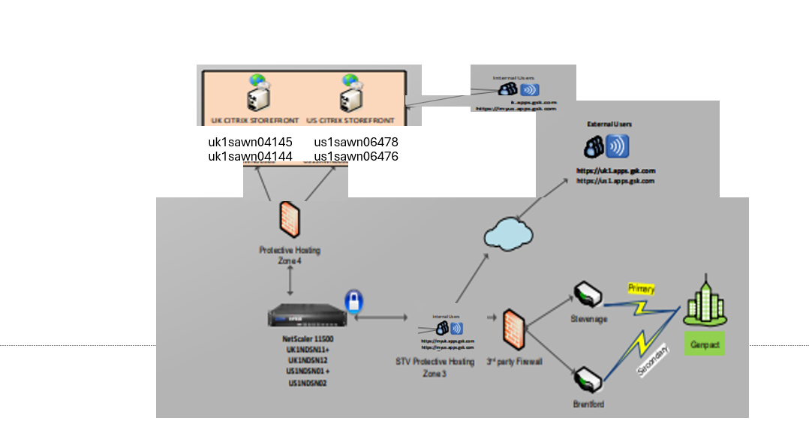
Tech Stack & Architecture Diagram - EAS: VDI Gateway Services
CONFIDENTIAL

Slide 26
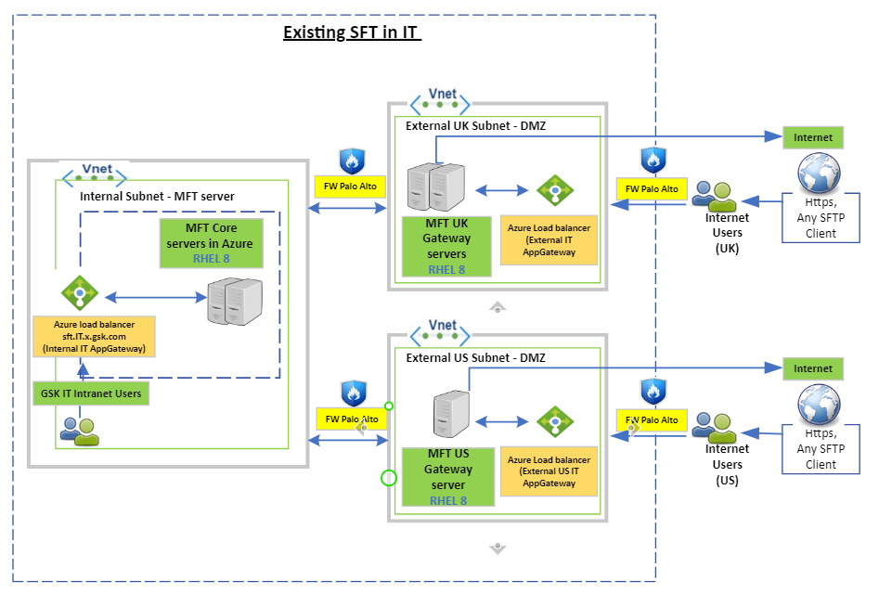
Tech Stack & Architecture Diagram - EAS: Managed File Transfer
High Availability SFT IT Application Solution
CONFIDENTIAL

Slide 27
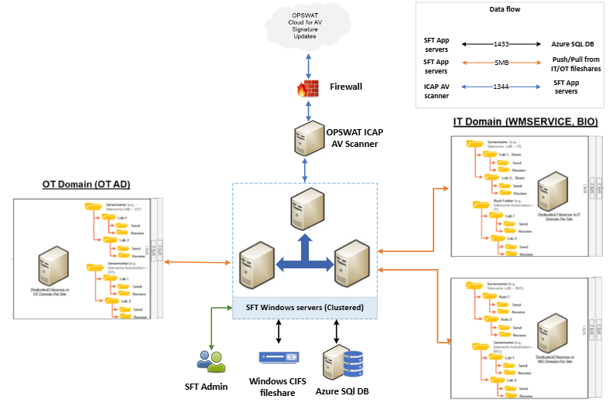
Tech Stack & Architecture Diagram - EAS: Managed File Transfer
High Availability SFT OT Application Solution
CONFIDENTIAL

Slide 28
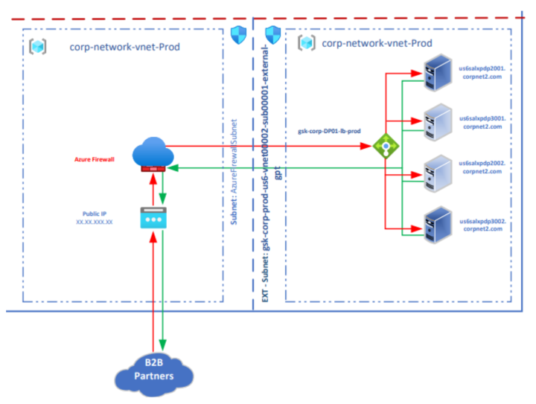
Tech Stack & Architecture Diagram - EAS: Web Service Security Gateway (WSSG)
CONFIDENTIAL

Slide 29
Ticket Data – Supporting Commentary
Support Level Required | L1 | L1.5 | L2 | L3
Response |  | Resolution | Schedule
P1 – Critical | 15 minutes | 2 hours | 24x7
P2 – High | 1 hour | 8 hours | 24x7
P3-Moderate | 4 hours | 3 days | 9-5 weekdays*
P4-Low | 8 hours | 5 days | 9-5 weekdays*
Support
Previous 12 months Ticket Data
 | Incident |  |  |  | Problem |  |  |  | Changes | Requests
 | P1 | P2 | P3 | P4 | P1 | P2 | P3 | P4
Virtual Apps & Desktops | 0 | 84 | 275 | 20227 | 0 | 0 | 0 | 0 | 622 | 9588
Netscaler (gateway service for VA&D) | 0 | 18 | 1 | 1 | 0 | 0 | 0 | 0 | 106 | 0
MFT | 0 | 4 | 166 | 678 | 0 | 0 | 0 | 0 | 33 | 1119
WSSG | 0 | 1 | 9 | 40 | 0 | 0 | 0 | 0 | 13 | 13
CONFIDENTIAL

Slide 30
New Scope – Secure Enterprise Browser
To be costed separately
App/ Service Name | Description of App/ Service | Current Annualised Spend | Current Supplier | Rationale for Out of Scope
Secure Enterprise Browser | A secure browser solution to strengthen data protection, streamline third-party access, and reduce VDI reliance. Integrate with enterprise security tools and support zero-trust principles | N/A | N/A | This is a new service currently going thru an RFI process with CSO team. Vendor and service package TBD.
 | Design | Build | Test/ QA | Op Support | Ongoing Development | Change Management | Decommissioning
SEB | Y | Y | Y | Y | Y | Y | Y
Scope Description
A secure browser solution to strengthen data protection, streamline third-party access, and reduce VDI reliance. Integrate with enterprise security tools and support zero-trust principles.
Dependency/linkage/synergy with any other Workpackages:
Cloud and LAN/WAN Network Infrastructure
Identity and Access Management
CSO, Global Risk and Compliance
Business application integration
There is no current contract as this would be a new solution for GSK
Expertise with design, build, Ops support, ongoing development, improving user experience, change management, service reporting and communications, and decommissioning
Provide all necessary management and support with respect to all of GSK’s secure enterprise browser tools, functions and services, including policy definition, centralized configuration, extension management, controlled updates, alerting and analytics, and compliance reporting
Would expect a resource-unit based cost model from MSP with fixed cost for scaling up or down as required
Staff should be properly trained in secure enterprise browser solutions.
30
CONFIDENTIAL

Slide 31
Scope Executive Summary – EAS: Secure Enterprise Browser
New Contract Term (Yrs)
Support | Dev | Hybrid
Solution Description
 | Design | Build | Test/ QA | Op Support | Ongoing Development | Change Management | Decommissioning
SEB | Y | Y | Y | Y | Y | Y | Y
Secure Enterprise Browser (SEB)
A secure browser solution to strengthen data protection, streamline third-party access, and reduce VDI reliance. Integrate with enterprise security tools and support zero-trust principles.
Dependency/linkage/synergy with any other Workpackages:
Cloud and LAN/WAN Network Infrastructure
Identity and Access Management
CSO, Global Risk and Compliance
Business application integration
There is no current contract as this would be a new solution for GSK
Expertise with design, build, Ops support, ongoing development, improving user experience, change management, service reporting and communications, and decommissioning
Task Details & Expected Outcomes
Provide all necessary management and support with respect to all of GSK’s secure enterprise browser tools, functions and services, including policy definition, centralized configuration, extension management, controlled updates, alerting and anlystics, and compliance reporting
Would expect a resource-unit based cost model from MSP with fixed cost for scaling up or down as required
Staff should be properly trained in secure enterprise browser solutions.
Dev Scope
 | Incidents | Problems | Changes | Requests
SEB | N/A | N/A | N/A | N/A
Ticket Summary
(Annualised)
AI First Strategy
Product Strategy/2026 Major Milestones
Focus on improved monitoring and observability to support AI Ops.​
Expertise in the platforms and investment in tooling to support GP&T AI Ops goals.​
Use AI and automation to improve service reliability, speed repairs and improve CX.
Migration of current Citrix estate to secure, modern, scalable solution
31
CONFIDENTIAL

